Slide 1
Week 3

Slide 2

From MLPs to CNNs for images
Sarina & Nick

Slide 3
Multi-Layer Perceptrons
Has an input layer, output layer, and at least one hidden layer
Require a one dimensional input vector
Every neuron connects to every neuron in the following layer
The Multilayer Perceptron (MLP) procedure produces a predictive model for one or more dependent (target) variables based on values of the predictor variables (ibm, n.d)

Slide 4
Convolutional Neural Networks
Operation used to scan an image with a small filter/kernel.
made from artificial neurons that learn weights
many layers of these computations connected together
Convolutional Neural Networks (CNNs) are unique neural networks for image recognition and computer vision (ibm, n.d)

Slide 5

Convolution Layer

Slide 6
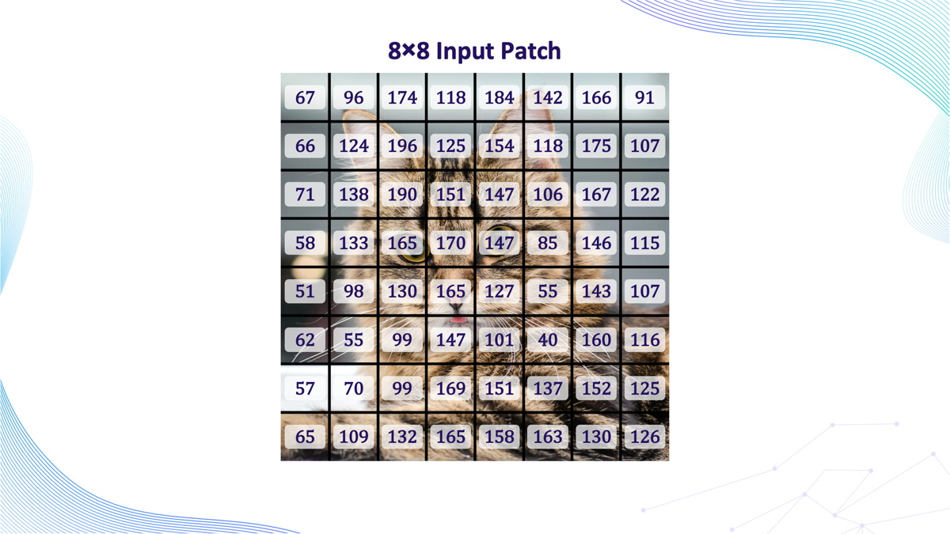
Notes:
Detects by brightness

Slide 7
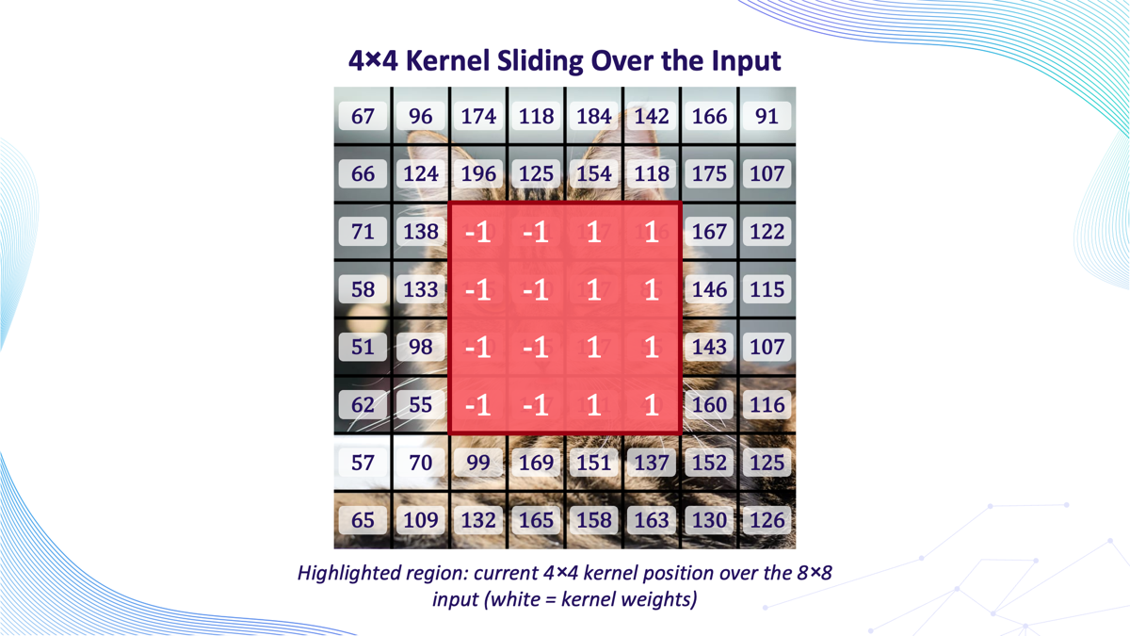
Notes:
The kernel we used is a vertical edge detector
It compares the average brightness on the left side of the kernal to the average brightness on the right side. If there's a big brightness difference between left and right — like where the cat's darker fur meets a lighter background — the kernel produces a large output (positive or negative). If the left and right sides are similar in brightness, the output is close to zero.

Slide 8
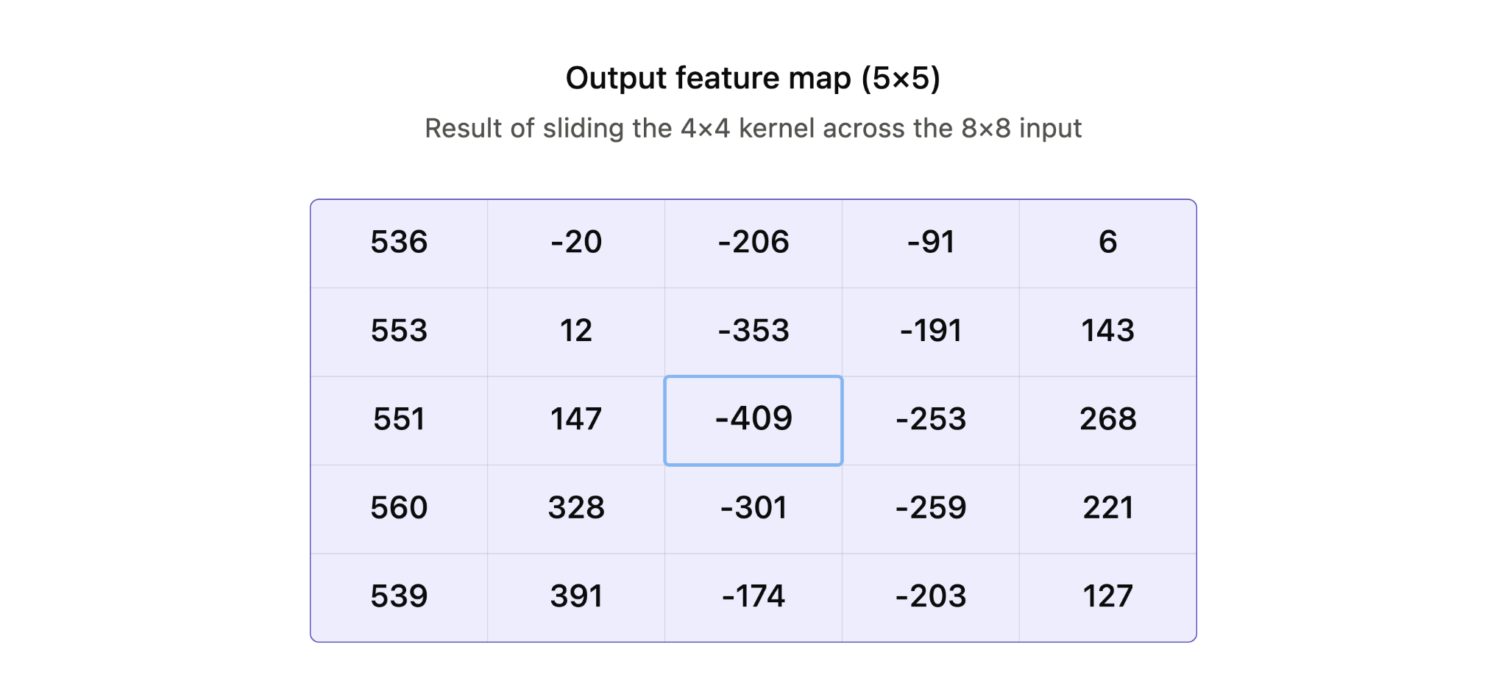
Notes:
Reuse the kernel over the whole image and get a feature map, so once it learns to recognize something in one place, it can spot it anywhere in the image
The left column (j=1) is strongly positive across every row (~536–560) — makes sense, since that column of the sliding window sits over the transition from background into the cat's face, where the left side of the patch is consistently brighter than the right.
The middle column (j=3) is strongly negative — that's the region centered right on the cat's eyes/nose area, where the pattern reverses.

Slide 9
Activation Layer
Pooling Layer
Fully Connected Layer
-100
442
-100
442
232
291
232
291
442
283
331
407
364
319
Notes:
Activation Layer (ReLU)-> After each convolution, ReLU passes positive values through and zeroes out anything negative
Pooling Layer-> Shrinks each feature map by summarizing small regions (e.g. 2×2) into a single value (max pooling keeps the strongest signal)
Fully Connected Layer-> Feature maps get flattened into one long list, then fed through a dense layer that combines everything to start making a decision.

Slide 10
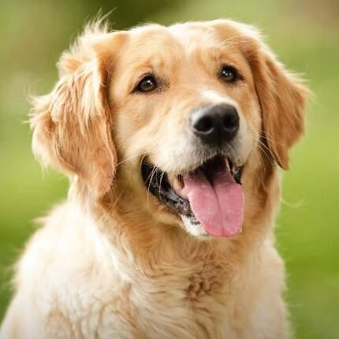
Classifier (Softmax)
Cat
Dog
Probability: 92%
Probability: 26%
442
283
331
407
364
319
Notes:
The final layer turns the fully connected output into a probability for each class
Softmax makes sure all the probabilities add up to 100%
Highest probability = the network’s prediction (e.g. “cat”)

Slide 11
Putting It All Together
Early on in convolutions, the network notices simple things (edges, lines, corners)
Those get combined into slightly more complex shapes (curves, textures)
Eventually those combine into recognizable objects (eyes, a wheel, a face)
Flattening happens at the end then classification.

Slide 12

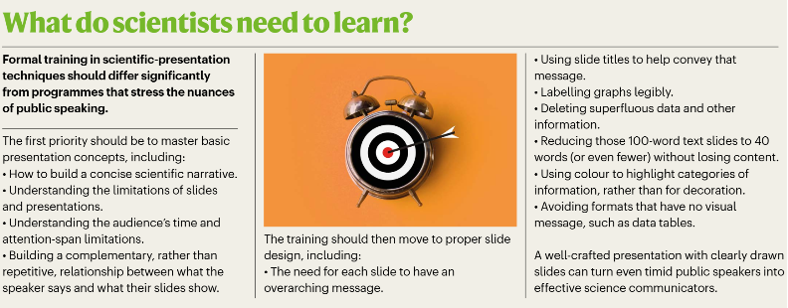
Polished Talks Benefit Careers
Review by Sarina & Nick

Slide 13

Review by Sarina & Nick

Slide 14
Week 4

Slide 15



Progress So Far
Received the dataset of images from biology professor.
Analyzed the folders/filenames to separate attributes
Wrote a script to run through the dataset
Designed a dashboard to represent current csv data.

Slide 16
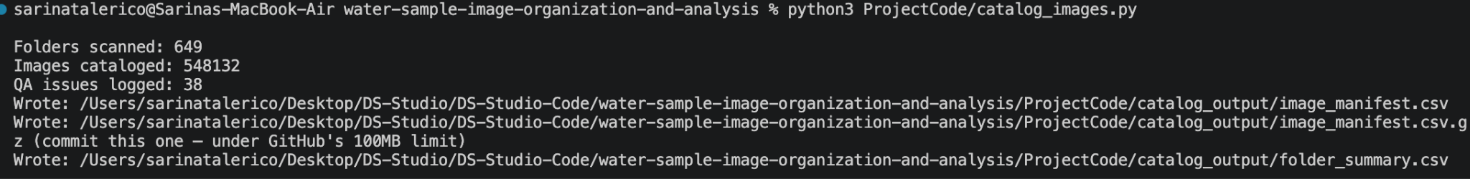
~550,000 images in the dataset
From the 648 total folders, 77 are raw, and 571 are -pp.
out of the 77 raw, 34 are pairs with -pp, and 43 are standalone

Slide 17
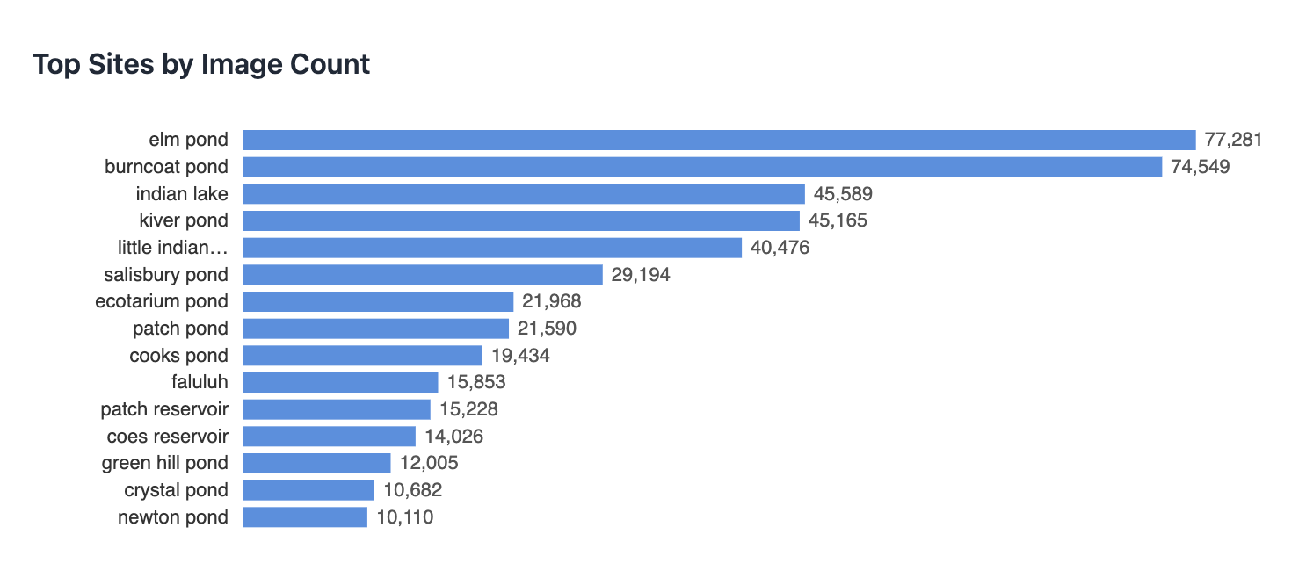

Slide 18
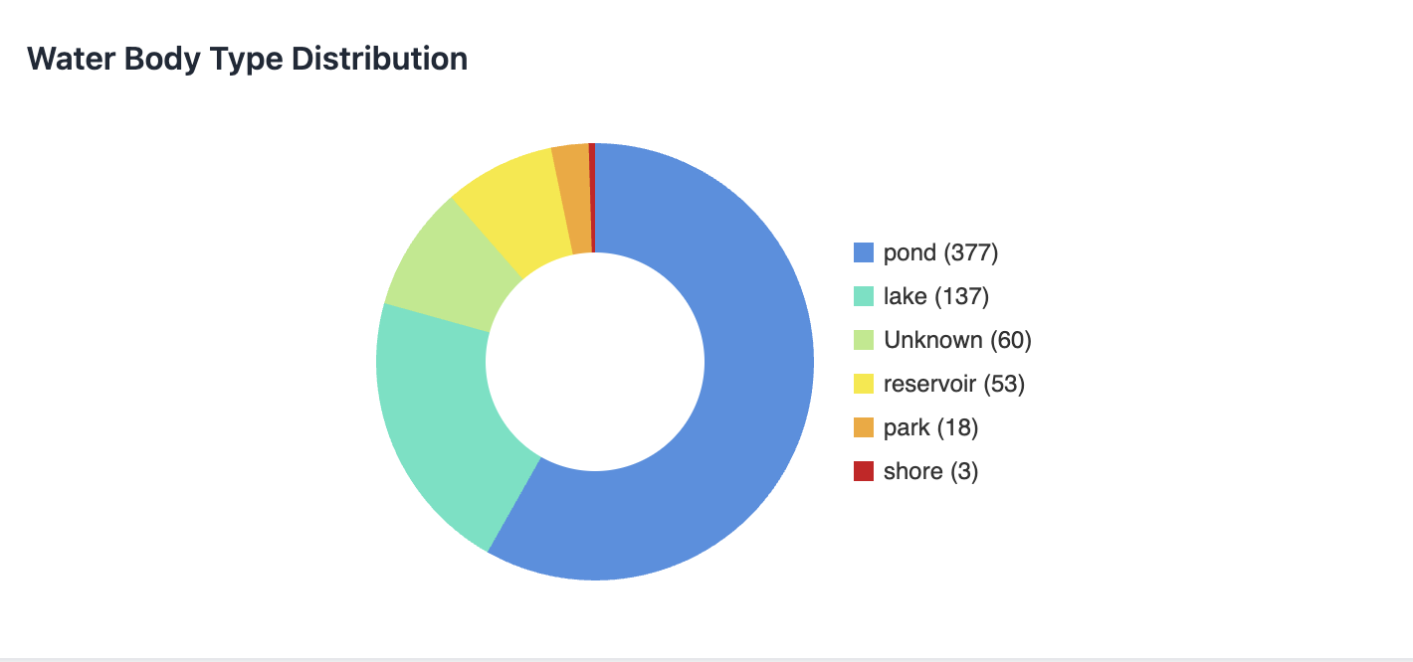

Slide 19
Challenges
-649 raw folders with no consistent naming convention
-Didnt know whether to normalize names or to separate them
-37 folders are missing magnification info
-Didnt know what -pp was; then discovered it wasnt a clean filter (90% success rate)
-Some -pp folders included duplicates from their raw counterparts

Slide 20
Prof. Ahlgren Update: Most Recent State
pp = post-processing
AI = autoimage mode; TR1/TM = trigger mode (preferred, standardized post-2022)
Dilution 0.1/0.5 = diluted 1:10/1:5; none listed = undiluted
Magnification: 10X standard, 4X for high concentration; none listed = assume 10X
Prefiltering: assume 50µm if noted
Notes:
; removes blanks (sometimes filaments too); use PP folders per city standard

Slide 21
Next Steps
Organize dataset using the PP folders (city's standard pipeline)
Include AI and TR1/TM as modes in csv file
Record prefiltration as attributes in the script
Incorporate the new 2024 dataset
Decide on a database to start using

Slide 22
Week 5

Slide 23
Progress
tune
01
language
02
account_tree
03
Script Optimization
Slight tweaks to script and dashboard to improve organization and clutter
Website Roadmap
Made two plans to move the project to a fully functional website
Visual Mapping
Created a visual representation of the two possible roadmaps made

Slide 24
Progress
04
tune
05
06
Met with Prof. Ahlgren
Met with the Biology professor to learn about the data and how they turn it into a dataset.
Cut 31,605 duplicate images from dataset
31,605 images were byte-identical duplicates present in both -pp and raw version. Redundant copies are eliminated by switching to -pp
Met with Prof. Catalin
Met with Professor Catalin who gave us advice on databases and how we should expect to work with our data.

Slide 25


Website Roadmap - $0/Month
Image Storage
01
Image Access
02
Database
03
Hosting
04
Cloudflare R2 free tier
Cloudflare Worker
Supabase free tier
Cloudflare Pages

Slide 26

Website Roadmap - $7/Month
Image Storage
01
Backend
02
Database
03
Hosting
04
Cloudflare R2 free tier
Render Starter
Render Postgres
Cloudflare Pages

Slide 27
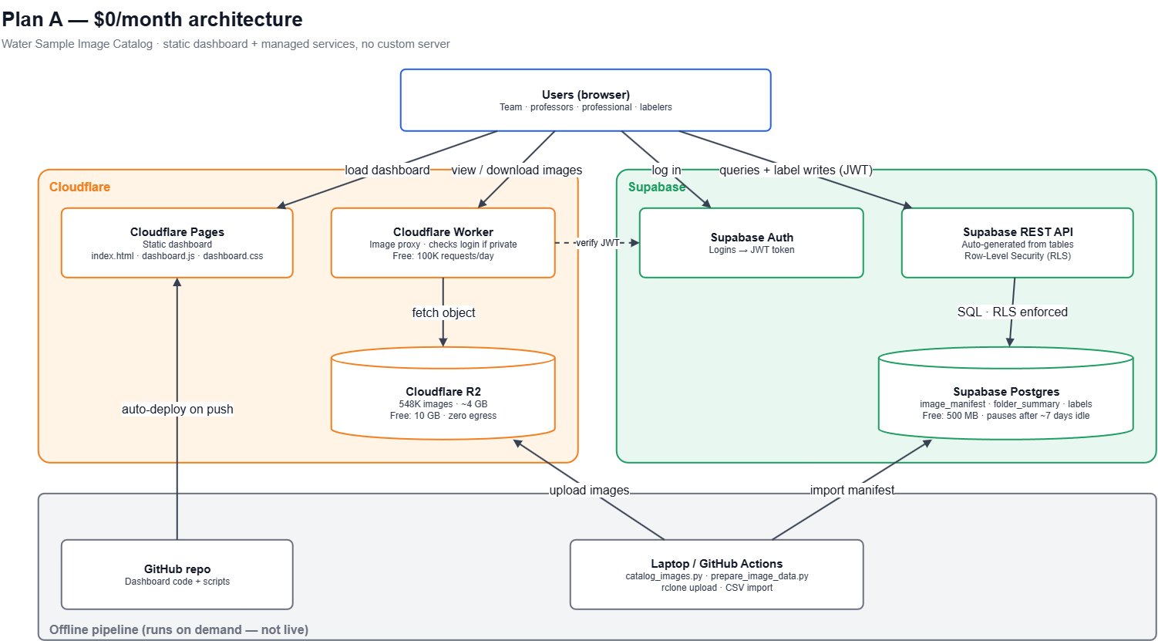

Slide 28
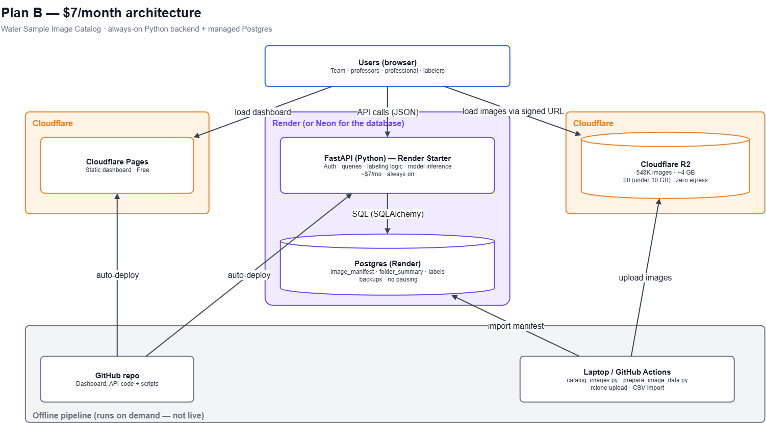

Slide 29


Challenges
wrong_location
Site Name Discrepancies
Need to confirm whether Patch Pond vs. Patch Reservoir, Coes Pond vs. Coes Reservoir are two different sites or inconsistent.
01
folder_off
Unprocessed Folders
43 folders are raw, and therefore inconsistent with the rest.
02

Slide 30
Next Steps
dataset
01
analytics
02
desktop_windows
03
psychology
04
Database Integration
Begin connecting the database to the current dataset.
AI Shift Analysis
Analyze how AI/trigger modes changed before vs. after 2022 in the data.
Visualization Software
Review Prof. Ahlgren's computer to use the visualization software for data.
ML & Labeling Strategy
Brainstorm a machine learning and labeling approach to the data.

Slide 31
Utility of Posters
Sarina & Nick
Notes:
The background of the "What Is the Utility of Posters?" paper establishes that while academic posters are extensively used at scientific conferences, their actual value to presenters and viewers remains poorly documented. Most existing literature focuses heavily on poster design and visual appeal rather than their effectiveness in knowledge transfer. Because of this gap, there is limited empirical evidence on whether posters truly facilitate learning or how they compare to traditional oral presentations. Consequently, the study investigates conference delegates' experiences to understand the unique strengths, weaknesses, and educational utility of poster presentations in academic and professional settings.

Slide 32
PROS
✓ Sources of inspiration
✓ Flexibility
✓ Enabling personalization of the conference program
✓ Facilitation of networking
✓ Good for early career presenters

Slide 33
CONS
✕ Too little information
✕ Less prestigious than oral presentations
✕ Challenging to prepare
✕ Monopolizing presenter's time at conference

Slide 34
Suggestions to Improve
+ Schedule adequate and dedicated viewing time
+ Central and prominent hub for the posters
+ Provision of an environment conducive to discussion
+ Requirement to display contact details
+ Show poster abstracts

Slide 35
Week 6

Slide 36
Progress So Far
01
Fixed script to normalize site names and work for cross-platform (mac+windows)
02
Secured the laptop from Prof Ahlgren
03
Built a labeling page where admins/labelers click images to bulk-apply labels and the dashboard showing overall/per-person progress
04
Added a sign in feature through Supabase and login with google through it’s cloud console
05
Dashboard now pulls from supabase instead instead of local files
06
Cloudflare hosted now running on https://water-sample-dashboard.pages.dev/

Slide 37
Challenges
01
Connecting to Github to Cloudflare
02
Supabase had an error till noon
03
Cloudflare initially failed to launch/host the dashboard
04
Github had a problem merging ‘host’ branch to ‘main’

Slide 38
Next Steps
01
Have Cloudflare pull from original repo
02
Talk to Professor Ahlgren about publicly of images and dashboard
03
Perfect the labelling feature
04
Create a request role feature

Slide 39
Paper Talk: A FlowCam Image Pipeline
Pipeline for FlowCam data processing with modular open-source software and optional machine learning classification
Symiakaki, Walles, Park, Yalçın, Siangsano, Berger, Nejstgaard. PeerJ, March 2026
Notes:
This paper is about what to do after a microscope-style instrument has produced a lot of images. That is our situation too.
Scientists who study tiny water organisms (plankton) now use cameras attached to microscopes instead of looking through them by eye. One such camera is the FlowCam. Water flows past it, it snaps thousands of pictures of the particles in the water, and it also measures each particle (size, shape, color).
Taking the pictures is easy. Dealing with them is hard. The software that comes with the FlowCam costs money, only runs on Windows, and handles old file versions badly. It also doesn't help much with automatically identifying what's in each picture. We’re going to look into this paper and discuss why it came to, what they did to solve this issue and their results.

Slide 40
N
Why the camera beats microscope
Speed: process far more samples and organisms in the same time
Complete measurements: size and shape for every organism
No spoilage: samples are imaged right away, before preserved samples degrade
Live samples: delicate organisms that preservatives would destroy can still be counted
Rare finds: high volume makes rare organisms more likely to be spotted
Notes:
Cameras handle far more samples, measure every organism instead of a few, and keep the pictures so anyone can re-check them later. They also avoid problems where samples spoil while waiting for a person.

Slide 41
I
The bottleneck
The FlowCam produces thousands of images per sample, each with up to 60 measurements, far too many to sort by hand
Its software (VSP) costs money and runs only on Windows
Old software versions save images bundled into "collage files" that must be extracted before use
Newer version 6 exports single images but can't open old datasets
Sorting images into categories creates many separate files that are easy to mix up
Notes:
The camera makes huge numbers of images, but the official software is expensive, Windows-only, and awkward with old files. Processing, not collecting, is the hard part

Slide 42
N
Pipeline overview
Clean up (Python script): standardize the data, flag duplicates and too-small or too-large particles
Label (LabelChecker app): a person views the images and assigns or checks labels
Classify (optional AI model): learns from the labels, guesses the rest, and a person corrects the guesses
Every step reads and writes the same CSV file, one per sample
The original data is never changed
You can stop at any step: clean data, hand labels, AI labels, or checked labels
Notes:
The key idea is that all three steps share one spreadsheet for each sample. Cleaning adds columns, labeling fills in labels, and the AI adds its guesses, all in the same file. Because the file format is the shared link, you can replace any step with your own tool. The AI step is optional because the first two steps are already useful on their own.

Slide 43
Preprocessing Step 1: Cleaning
A Python script reads the FlowCam's data files (CSVs) from 7 different software versions (of VisualSpreadsheet)
Different versions name the same measurement differently, so it renames them to one standard
It adds 7 new columns to the end of each file: labels (automatic and human-checked), biovolume (3D volume of particle), and surface area
It runs before labeling, so later steps have fewer, cleaner images
Each cleanup feature can be turned on or off
Notes:
The raw files from different software versions don't match, so the first job is making them consistent. The script standardizes the column names, then adds empty columns that will later hold labels and calculated values. Cleaning first matters because a classifier can't tell, for example, that two images are the same particle photographed twice. That needs information about the order the images were taken in.

Slide 44
N
Preprocessing Step 2: Duplicates + Size
The script flags an image as a duplicate if any one of these is true:
  Taken right after the other image
  It sits within 100 pixels of the other
  Its box overlaps the other's by at least 30%
  Its measurements are 99.9% identical to the other's
Flags can be wrong, so a person checks them in LabelChecker
Size filter: images with few pixels or large particles low in amounts are dropped.
Also estimates each particles 3D volume
Notes:
Before labeling, the script removes images that would waste time or confuse a model. Duplicates are the same particle photographed twice, so the script checks whether two images were taken close together, in about the same spot, with overlapping boxes, or with nearly identical measurements. It also sets aside particles that are too small to recognize. The authors admit it flags too many duplicates, but they argue it is quicker to fix a few wrong flags than to search the whole dataset for duplicates by hand.

Slide 45
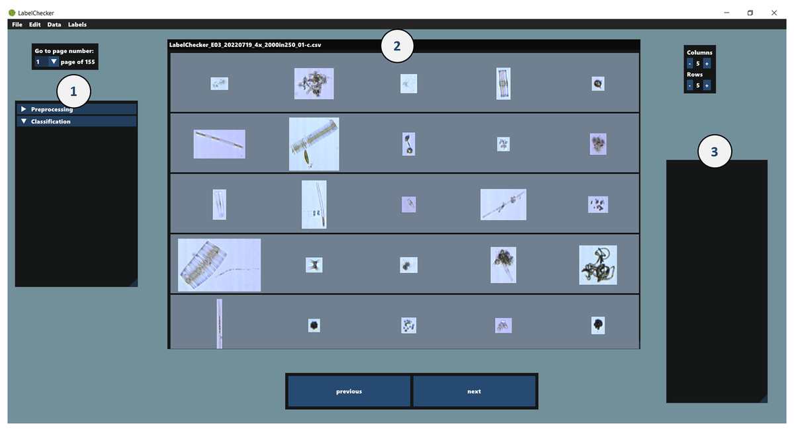
LabelChecker
A free app for labeling images
  Shows your images in a grid
  Click images, press a key to label them, and it saves your work
  Can also show AI guesses for you to accept or fix
Notes:
LabelChecker is where a person looks at the pictures and tells the computer what each one is. You can label from scratch, or let the AI guess first and just correct its mistakes, which is much faster.

Slide 46
N
Demo Classifier
An AI model of a CNN and MLP combined that takes two inputs:
  The picture of the particle (for the CNN to see)
  The measurements of the particle (size, shape, color) (for the MLP to read)
The outputs are passed through a few final layers that pick the label
Kept small so it runs on an ordinary computer
Person labels some images in LabelChecker → model learns from them → model guesses the rest → person corrects the guesses in LabelChecker → repeat
Notes:
The model looks at each particle two ways: what it looks like, and what its numbers say. Using both gives it more to go on.

Slide 47
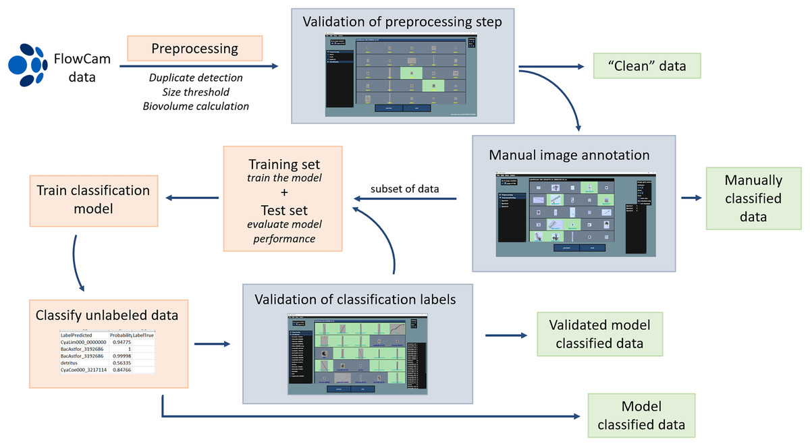
I

Slide 48
I
Results
 | Freshwater Marine | Freshwater Marine
Classes | 32 | 20 broader groups
Labelled Images | 41,202 | 6,540
Accuracy | 87% | 88%
Notes:
Good accuracy with a small model and a modest labeled set,

Slide 49
N
Strengths and limitations
Strengths
Free and works on any computer
Handles data from many software versions
Everything for one sample stays in a single file
Limitations
The size filter can wrongly flag long, thin organisms (happened to us)
Duplicate detection sometimes flags too much, so a person must check through dozens or hundreds of quality images
The model is only a demo and struggles with rare types
Notes:
The big win is that it's free and flexible. The authors are upfront about the weak spots: the automatic filters need a human to double-check them, and the demo model is a starting point, not a finished classifier.

Slide 50
I
Our project using the same pipeline
Paper | Our project
Unify output across software versions | catalog_images.py parses site, date, sample code, and dilution from folder names
Remove duplicates | Prefer the -pp folder over its raw twin
One CSV per sample | image_manifest.csv and folder_summary.csv
LabelChecker | Our dashboard (filters, folder view)
Labels in the CSV | Empty label column to fill in, image IDs are set
Notes:
We built the first half of this pipeline without having seen the paper.

Slide 51
N
Conclusion/Lessons to copy
Agree on label categories with Prof. Ahlgren
Add a labeling and validation view to the dashboard (select several images, assign a label, save)
Label a varied starter set of images
Train a small model, then correct its mistakes and repeat
Test on samples the model hasn't seen
Notes:
The big win is that it's free and flexible. The authors are upfront about the weak spots: the automatic filters need a human to double-check them, and the demo model is a starting point, not a finished classifier.

Slide 52
Week 7: Final Presentation

Slide 53
Motivation
The problem
Harmful cyanobacteria blooms can make drinking water and local water bodies unsafe
Monitoring means looking at water samples under a microscope by hand
That is slow, and it depends on a trained person
The City of Worcester, WCMC (Worcester Cyanobacteria Monitoring Collaborative) and Prof. Nathan Ahlgren study these samples
Notes:
Our project starts with a real problem. Cyanobacteria are tiny organisms in lakes and ponds, and when they grow out of control they form harmful blooms that can make water unsafe. The way people check for them is mostly by looking at samples under a microscope, one at a time. That takes a lot of time and a lot of expertise. Worcester’s water is monitored by the city and by WCMC, and our advisor Professor Ahlgren studies the samples, so this is data from our own community

Slide 54
The FlowCam
A FlowCam is a microscope camera that photographs particles in flowing water
It takes thousands of pictures per sample
Faster than a person, and the images can be re-checked later
Machine learning could help identify what is in each picture
Notes:
To speed this up, the lab uses a FlowCam. Water flows past a camera, and it takes thousands of pictures of the particles in it. That’s much faster than a person, and the pictures are saved so anyone can look again later. The goal is to train a machine learning model that can recognize cyanobacteria in those pictures automatically. But a model needs organized, labeled images, and that’s where the problem is.

Slide 55




















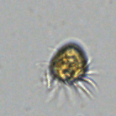








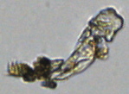




What we started with
About 550,000 images in 648 folders
No consistent folder naming
Could not search by site, date or magnification
Nothing labeled, so nothing a model could learn from
Notes:
When we got the data, it was about 550,000 images in 648 folders, and the folders were named in lots of different ways. You couldn’t search for a site or a date, you couldn’t compare samples, and none of the images were labeled. So the camera did its job, but the data wasn’t usable yet. That is the gap we worked on

Slide 56

Our Plan
Goal: turn raw FlowCam folders into a clean, searchable, labelable dataset
Step 1: organize it with a Python script
Step 2: put it in a database and dashboard
Step 3: build a tool for people to label images
Notes:
So our job was to build the foundation. We organize the data with a script, put it in a database with a dashboard anyone can use, and then build a tool so people can label images. Once that’s done, the machine learning work can begin

Slide 57
Methodology: Learning the data
Met with Prof. Ahlgren to learn how the data is made
-pp means post-processed, the city’s standard
TR/TM = trigger mode and AI = autoimage mode
Dilution is in the name, and magnification is 10x unless noted
Also learned from a paper on a FlowCam image pipeline
Notes:
Before writing code, we had to understand the data. We met with Professor Ahlgren, who explained the folder names. For example, ‘pp’ means post-processed, which is the city’s standard version. The codes in the name tell you the capture mode, the dilution, and the magnification. We also read a paper on FlowCam pipelines, which showed the same steps we ended up following: clean the data, then label it, then train a model.

Slide 58
Step 1: Python Script
Reads each folder name and extracts site, date, magnification, dilution and capture mode
Cleans up site names
Uses the -pp folder when both versions exist
Checks that every image opens (Pillow)
Output: one spreadsheet row per image (folder_name site_raw site_normalized, water_body_type, date, magnification, sample_code, capture_mode, dilution, is_pp, image_count, unreadable_count)
Notes:
The first step is a Python script. It goes through every folder, reads the name, and pulls out the site, date, magnification, dilution and capture mode. It fixes inconsistent site names, and if there’s a raw folder and a post-processed one for the same sample, it uses the post-processed one. It also checks that every image actually opens. The output is a spreadsheet with one row for every image.

Slide 59
Step 1: Script Results
511,765 images
613 folders, 45 sites, 36 sampling dates
0 unreadable files
31,605 duplicate images removed by using -pp folders
Notes:
Here are the results of the script. The final catalog has 511,765 images from 613 folders, 45 sites and 36 sampling dates, and none of the images were unreadable. We also found that 31,605 images were exact duplicates sitting in both the raw and the post-processed folders, and switching to the post-processed ones removed them.

Slide 60



Step 2: Choosing a database
Notes:
We had a meeting with Professor Catalin, Professor Potter, and Professor Han about databases. From that we came up with a $7 a month plan and a free plan, which after meeting with Professor Ahlgren; why not free. The biggest challenge is to run it for $0 your server needs to be static for this type of project, each service fills a gap a static website can’t fill itself
Supabase covers the data, accounts and permissions:
A real Postgres database. Logins built in. Google sign-in, email and password, confirmation emails and password resets all come ready-made. Row-Level Security. Rules like “anyone can read, only labelers can save labels” live in the database, so the security holds even though the website code is public.
Cloudflare covers the website and the images:
Pages hosts the website and redeploys it automatically on every GitHub push.
R2 holds the 3.65 GB of images.
The Worker serves them quickly from Cloudflare’s global network.
Why not the obvious alternatives?
Images in Supabase Storage: its free tier is only 1 GB
Images in GitHub: 3.65 GB is far too large for a repository.
AWS only allows free for around 6-12 months then it ends and charges money for downloads
For render: Free database expires after about 30 days unless you upgrade

Slide 61
Why Cloudflare & Supabase work so well
What | Free limit | Our usage
Postgres database (Supabase) | 500 MB | ~168 MB
Image storage (Cloudflare R2) | 10 GB | ~3.65 GB (511,765 images)
Image downloads from R2 | free, with no bandwidth charge | —
Image server (Cloudflare Worker) | 100,000 requests per day | No more than 10,000 a day
Website hosting (Cloudflare Pages) | no traffic charge | —
Notes:
If the storage needs to increase for postgres or image storage switch to Supabase for $25 a month
If more requests is needed, $5 a month -> 10 Million Requests per Day

Slide 62
Notes:
[Whole diagram]
This is how our Water Sample Image Catalog runs online. There are three parts. On the left is Cloudflare, which serves the website and the images. On the right is Supabase, which holds our data and handles accounts. At the bottom is our offline pipeline, which is how new images get into the system. Everything here runs on free tiers, so hosting costs us nothing.
[Users box at the top]
It starts with a user in a web browser: our team, professors, or a labeler. They can do four things: load the dashboard, view or download images, log in, and, if they’re allowed, save labels on images.
[Cloudflare Pages]
“When someone opens the site, the dashboard comes from Cloudflare Pages. The dashboard is a static site: plain HTML, CSS and JavaScript files, with no server code running behind it. That’s why it’s fast and free to host. Pages is connected to our GitHub repo, so whenever we push changes, it rebuilds and redeploys the site automatically.” [trace the ‘auto-deploy on push’ arrow]
[Cloudflare Worker, then R2]
“The images themselves live in Cloudflare R2, which is cloud file storage. That’s over half a million microscope images, about four gigabytes. R2 has no download fees, which matters because people browse a lot of images. The browser never talks to R2 directly. It goes through the Cloudflare Worker, a small program that acts as our image server. You ask it for an image, it fetches that file from R2 and hands it back, or sends it as a download. It can only hand images out; nobody can change or delete them through it.”
[Supabase Auth]
“Now the Supabase side. When someone logs in, with Google or with an email and password, Supabase Auth checks who they are and gives the browser a token called a JWT. Think of it as a signed ID badge. The browser shows that badge with every request after that.”
[Supabase REST API, then Postgres]
“All of our data, every folder, site, date, image count and label, lives in a PostgreSQL database. The browser doesn’t connect to the database directly. It goes through Supabase’s REST API, which Supabase generates automatically from our tables. The important part is Row-Level Security. The rules about who can do what live inside the database itself. Anyone can read the catalog. Only labelers and admins can save a label, and even then they can only change the label column, nothing else. Only admins can change people’s roles. So even if someone tampered with the website code in their browser, the database would still refuse anything they aren’t allowed to do.”
[Offline pipeline at the bottom]
“Finally, the bottom box is how data gets in, and it only runs when we add new samples. First, our Python script, catalog_images.py, scans the raw image folders and builds a catalog: one row per image and a summary per folder. Then we import that catalog into the Postgres database. Then we upload the image files to R2 with a tool called rclone. Once that’s done, the new samples show up on the live dashboard automatically.”
[Wrap-up]
“To sum up: Cloudflare serves the website and the images. Supabase stores the data, handles logins and enforces permissions. The pipeline on our laptop feeds new images into both. Each piece does one job, it all fits in free tiers, and the security is enforced by the database, not by the web page.”

Slide 63
Step 3: The Dashboard
Anyone can browse, filter and download images
Filters: site, date, water body, magnification
Charts and a detail view for each folder
Light and dark mode, works on phones
Admin page that allows authorized users to change users access level
Available at: https://water-sample-dashboard.pages.dev/
Notes:
The dashboard is the front door. Anyone can open it without an account, filter by site, date and water body, see charts, and click a folder to see its images and download them. We also made it work on phones and added a dark mode

Slide 64
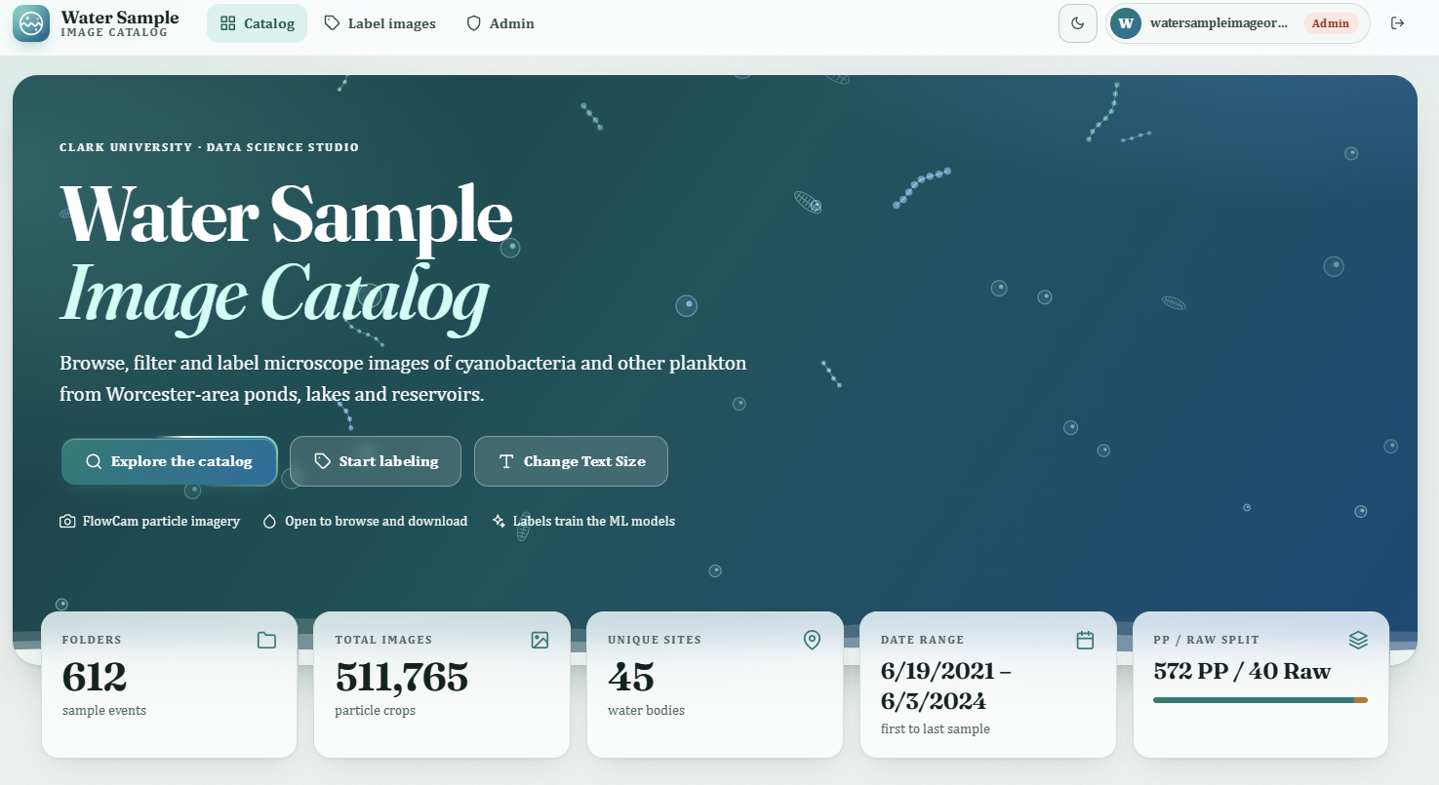
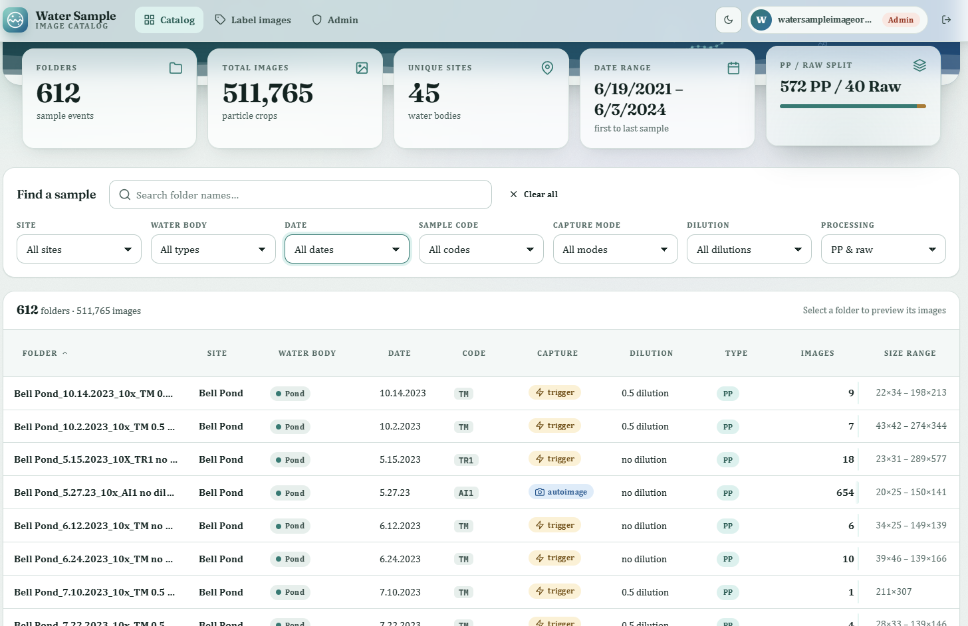
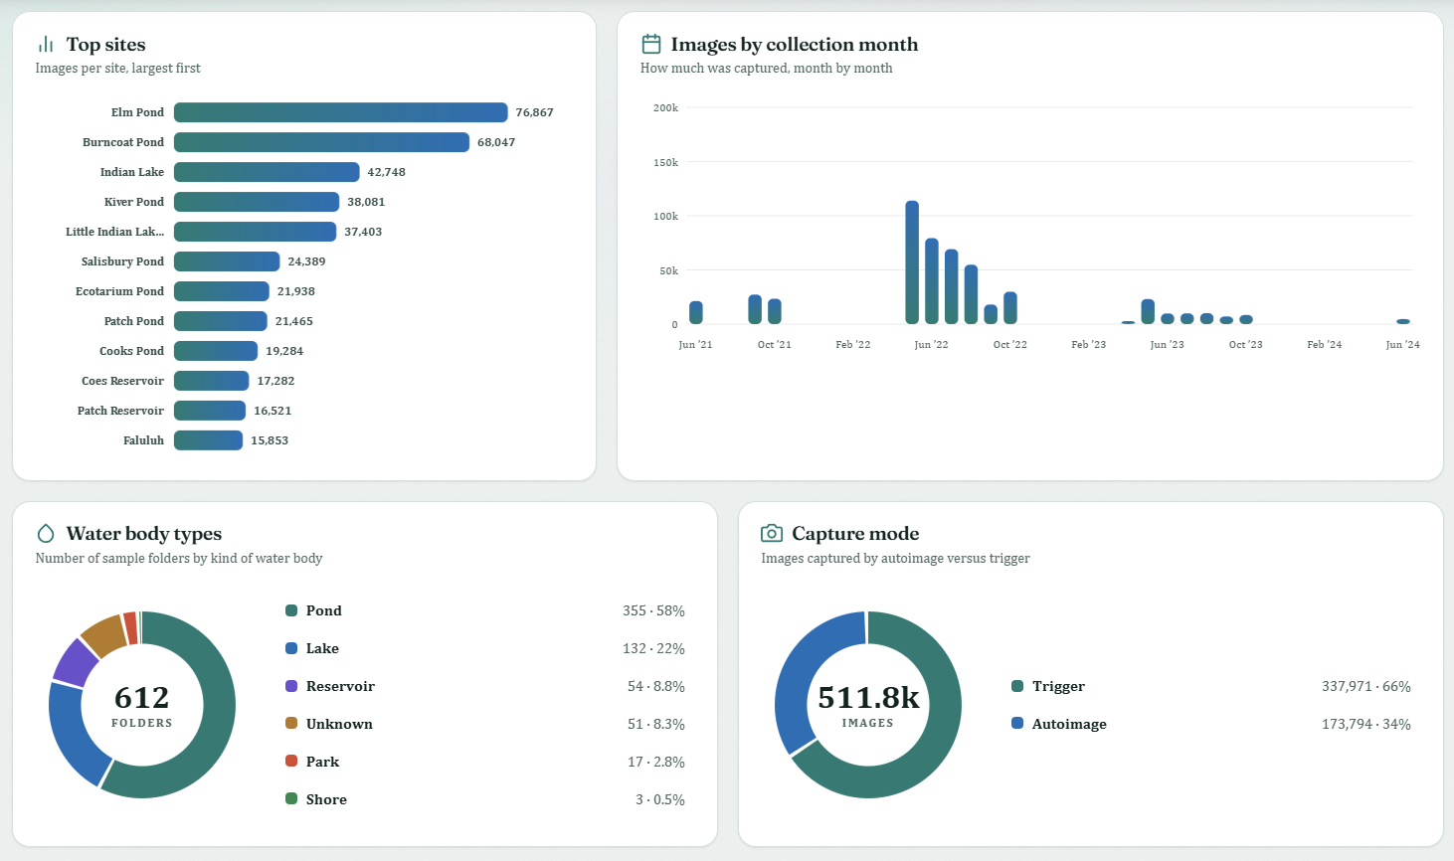
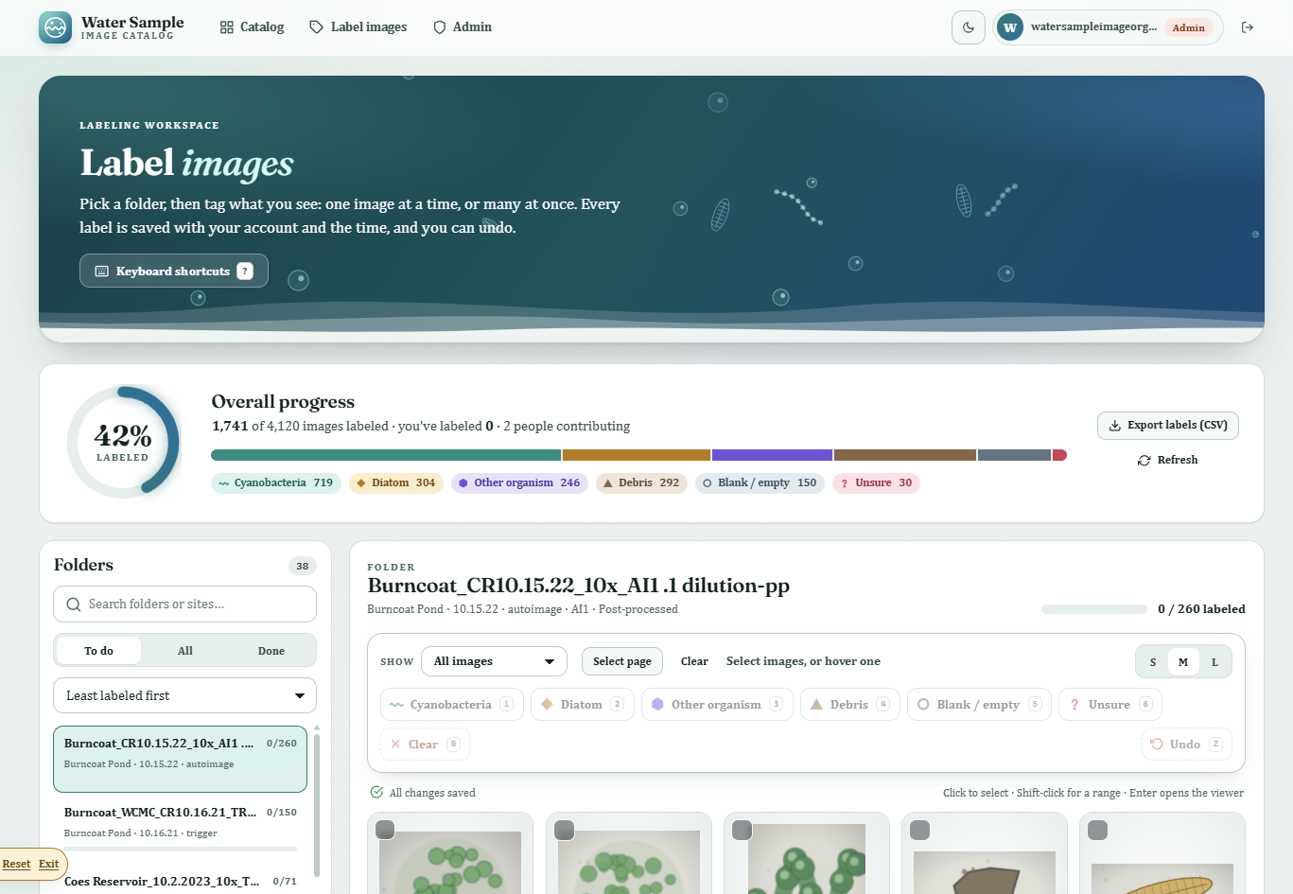
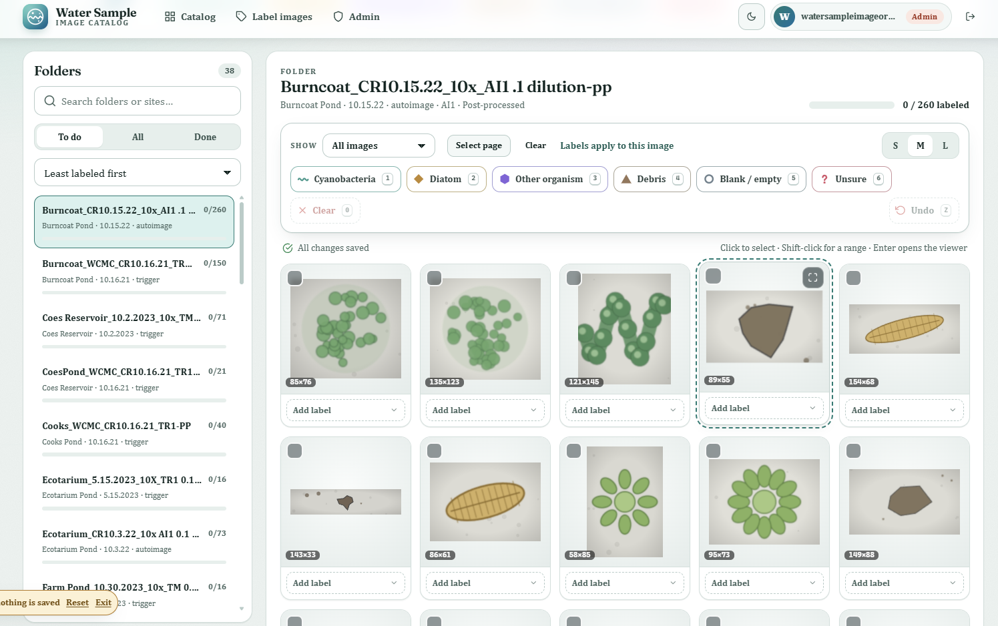
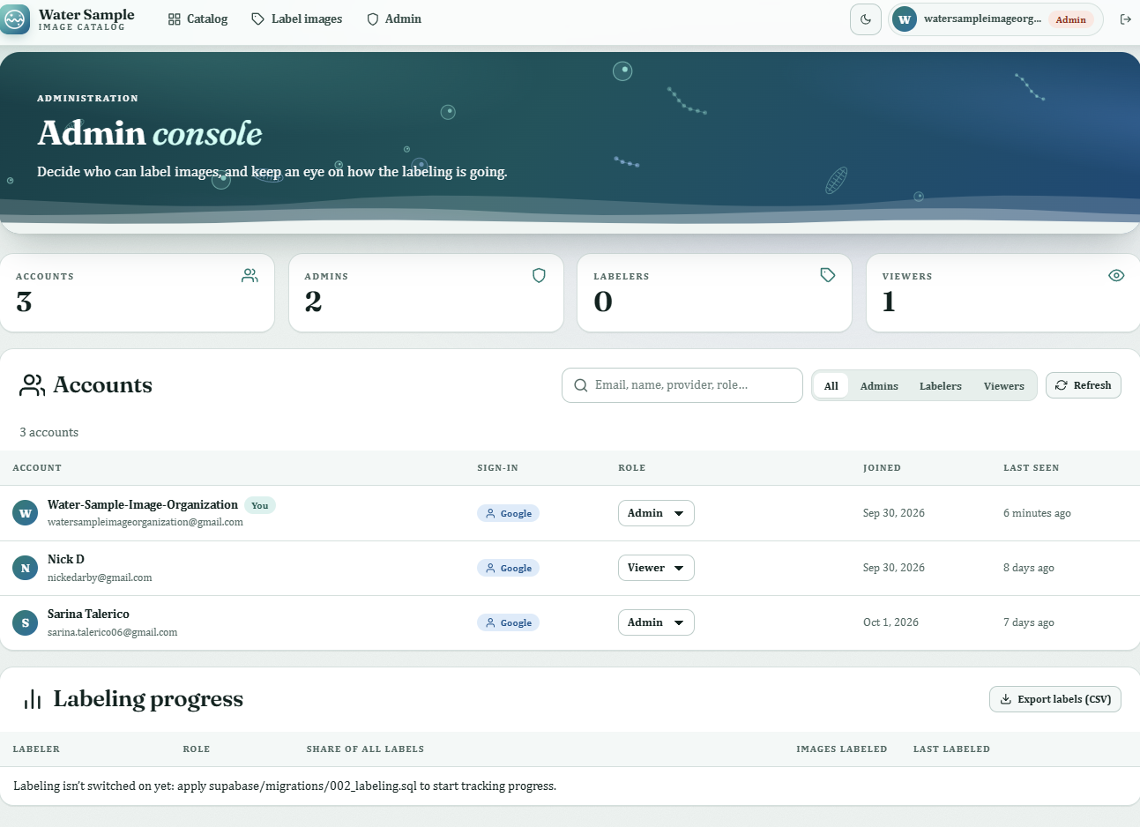

Slide 65
Step 4: Labeling
Select many images at once, or press number keys to label
Image viewer, undo, and progress tracking
Records who labeled each image and when
Export labels to CSV
Only approved users can label
Notes:
The last piece is the labeling tool, and this is where machine learning gets its training data. A labeler can select a whole group of images and press a number key to label them, open an image to look closely, and undo mistakes. It shows how much of the dataset is done, and the database records who labeled each image and when. Only approved users can label, and the labels export as a CSV for the model

Slide 66
Limitations
648 folders, no consistent naming
43 raw folders that didn’t match the rest
37 folders missing magnification
-pp wasn’t a clean filter, and some -pp folders duplicated their raw versions
Site names didn’t match: Patch Pond vs. Patch Reservoir, Chauncey vs. Chauncy
Notes:
We hit a lot of problems early on. The naming was inconsistent across 648 folders. Thirty-seven folders had no magnification. We didn’t know what ‘pp’ meant at first, and even after we did, it wasn’t a clean filter, because some post-processed folders repeated images from their raw version. We also couldn’t tell if names like Patch Pond and Patch Reservoir were one site or two. Most of these we fixed with the script and by asking Professor Ahlgren, but a few site names are still not merged.

Slide 67
Discussion
WCMC
Clark University Biology Department
Over 500 Thousand PNG files
?
Clark University Biology Department
WCMC
Notes:
So far the Worcester Cyanobacteria Monitoring Collaborative collects samples from around mass, sends them to Clark Uni where Bio department analyzes them with a flowcam using the proprietary visualspreadsheet6 software which in turn generated hundreds of thousands of images which didn’t have a place to be stored/analyzed

Slide 68

Future work
Determine label categories
Labelling system
Merge Chloe’s work
Perfect the admin page
Produce an ML classifier
Meet with users

Slide 69
Final Thoughts: What we built
A Python script that organized 511,765 images from 613 folders, 45 sites and 36 sampling dates
A free database and website: Cloudflare for images and hosting, Supabase for data and logins
A dashboard anyone can use to browse, filter and download images
A labeling tool with bulk labeling, undo, progress tracking and who/when records
Accessible design
Notes:
Let’s look at what we actually built. We started with about half a million images in folders nobody could search, and we ended with one organized catalog of 511,765 images across 45 sites. On top of that there’s a free database and website, a dashboard where anyone can browse, filter and download images, and a labeling tool where approved people can tag images and the system remembers who labeled what and when. We also made it accessible, with dark mode and a demo mode so anyone can try it without an account. And all of it runs on free services.

Slide 70
Final Thoughts: What we learned
Data is messy, most of the work was understanding the data, not coding
Ask early: Prof. Ahlgren’s answers (like what -pp means) helped us from wrong assumptions
Check your assumptions: -pp wasn’t a great filter, and we found 31,605 duplicates
Plan for the future: choosing a free setup keeps the project alive after the semester
Teamwork: the script, database, dashboard and labeling tool each came from a different part of the team
Notes:
We learned a few big things along the way. First, real data is messy, and most of our time went into understanding it rather than writing code. Second, asking the expert early matters. When we assumed what ‘pp’ meant, we were partly wrong, and Professor Ahlgren’s answers fixed that. Third, check your assumptions. We found 31,605 duplicate images only because we looked closely. Fourth, we picked a free setup so the project can keep running after this class ends. And finally, this only worked because the team split it up: the script, the database, the dashboard and the labeling tool each had owners who kept checking in with each other.

Slide 71
Before Vs After
Before: finding and comparing samples meant digging through folders by hand
Now: the data is searchable, documented and shared
It makes machine learning possible, because models need organized, labeled images
Notes:
We learned a few big things along the way. First, real data is messy, and most of our time went into understanding it rather than writing code. Second, asking the expert early matters. When we assumed what ‘pp’ meant, we were partly wrong, and Professor Ahlgren’s answers fixed that. Third, check your assumptions. We found 31,605 duplicate images only because we looked closely. Fourth, we picked a free setup so the project can keep running after this class ends. And finally, this only worked because the team split it up: the script, the database, the dashboard and the labeling tool each had owners who kept checking in with each other.

Slide 72
Thank you, Prof. Han, Prof. Potter, Prof. Ahlgren, & Prof. Catalin.
Sarina and Nick

Slide 73
Water Sample Image Organization and Analysis
By: Nick Darby, Sarina Talerico, and Chloe Halverson

Slide 74
Motivation
The problem
Harmful cyanobacteria blooms can make drinking water and local water bodies unsafe
Monitoring means looking at water samples under a microscope by hand
That is slow, and it depends on a trained person
The City of Worcester, WCMC (Worcester Cyanobacteria Monitoring Collaborative) and Prof. Nathan Ahlgren study these samples
Notes:
Cyanobacteria are tiny organisms in lakes and ponds, and when they grow out of control they form harmful blooms that can make water unsafe. The way people check for them is mostly by looking at samples under a microscope, one at a time. That takes a lot of time and a lot of expertise. Worcester’s water is monitored by the city and by WCMC, and our advisor Professor Ahlgren studies the samples, so this is data from our own community

Slide 75
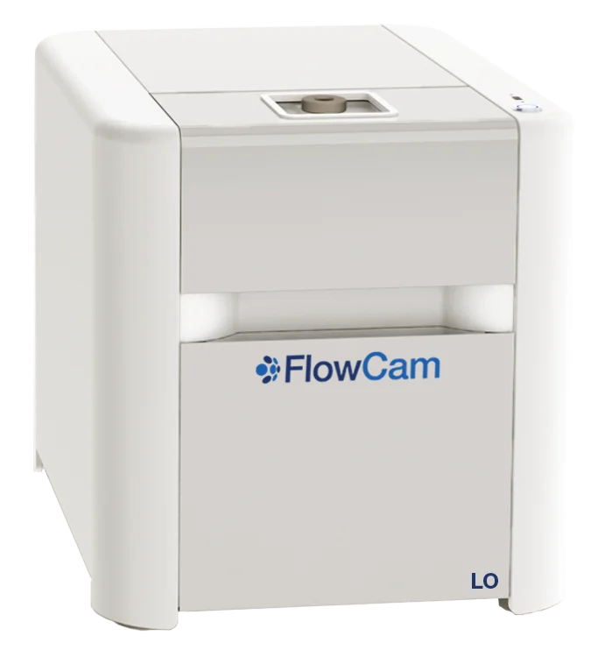
The FlowCam
A FlowCam is a microscope camera that photographs particles in flowing water
It takes thousands of pictures per sample
Faster than a person, and the images can be re-checked later
Machine learning could help identify what is in each picture
Notes:
To speed this up, the lab uses a FlowCam. Water flows past a camera, and it takes thousands of pictures of the particles in it. That’s much faster than a person, and the pictures are saved so anyone can look again later. The goal is to train a machine learning model that can recognize cyanobacteria in those pictures automatically. But a model needs organized, labeled images, and that’s where the problem is.

Slide 76
What we started with
About 550,000 images in 648 folders
No consistent folder naming (patch, patch pond, patch reservoir)
Could not search by site, date or magnification
Nothing labeled, so nothing a model could learn from
Notes:
When we got the data, it was about 550,000 images in 648 folders, and the folders were named in lots of different ways. You couldn’t search for a site or a date, you couldn’t compare samples, and none of the images were labeled. So the camera did its job, but the data wasn’t usable yet. That is the gap we worked on

Slide 77
Our Plan
Goal: turn raw FlowCam folders into a clean, searchable, labelable dataset
Step 1: organize it with a Python script
Step 2: put it in a database and dashboard
Step 3: build a tool for people to label images
Notes:
So our job was to build the foundation. We organize the data with a script, put it in a database with a dashboard anyone can use, and then build a tool so people can label images. Once that’s done, the machine learning work can begin

Slide 78
Methodology: Learning the data
Met with Prof. Ahlgren to learn how the data is made
-pp means post-processed, the city’s standard
TR/TM = trigger mode and AI = autoimage mode
Dilution is in the name, and magnification is 10x unless noted
Also learned from a paper on a FlowCam image pipeline
Notes:
Before writing code, we had to understand the data. We met with Professor Ahlgren, who explained the folder names. For example, ‘pp’ means post-processed, which is the city’s standard version. The codes in the name tell you the capture mode, the dilution, and the magnification. We also read a paper on FlowCam pipelines, which showed the same steps we ended up following: clean the data, then label it, then train a model.

Slide 79
Step 1a: Python Script
Reads each folder name and extracts site, date, magnification, dilution and capture mode
Cleans up site names
Uses the -pp (post processed) folder when both versions exist
Checks that every image opens
Output: one spreadsheet row per image (folder name, raw site, normalized site, water body type, date, magnification, capture mode, dilution, is post processed, image count, unreadable count)

Slide 80
Step 1b: Script Results
613
7.27%
0
Kept Folders
511,765 images
Unreadable Files
45 sites, 36 sampling dates
Reduced 7% of the images to keep relevant data
Every file was readable and data was clean

Slide 81
Step 2: Choosing a Database

Slide 82
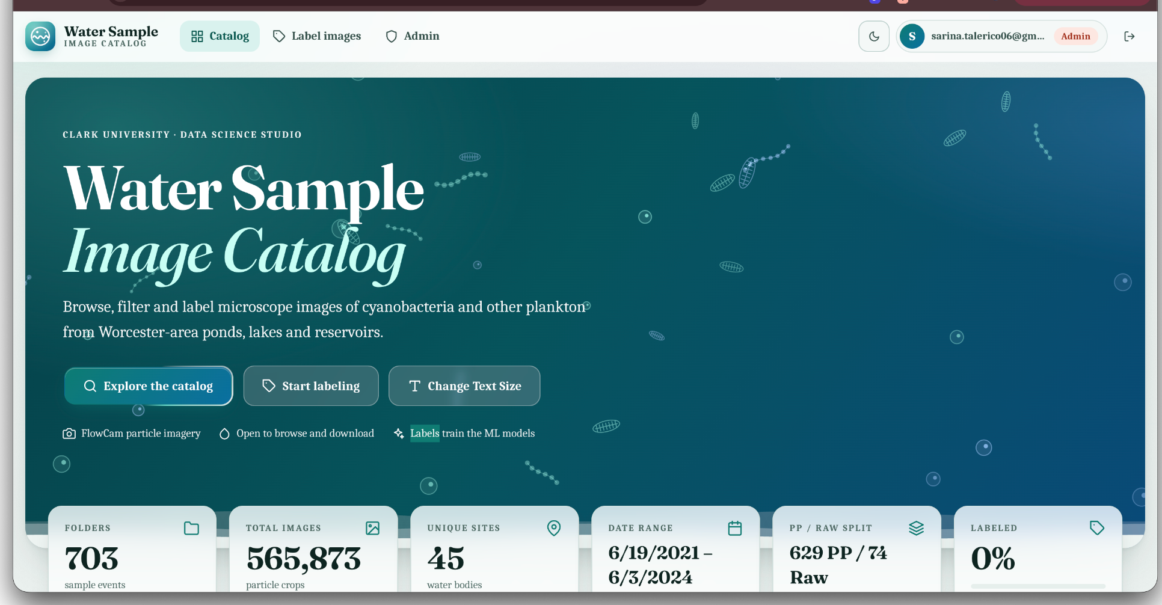
Step 3: Dashboard
Anyone can browse, filter and download images
Filters: site, date, water body, magnification
Charts and a detail view for each folder
A reverse engineer .vbd script added 60+ particle measurements
Admin page that allows authorized users to change users access level
Available at: https://water-sample-dashboard.pages.dev/

Slide 83
Step 4: Labeling
Select many images at once, or press number keys to label
Records who labeled each image and when
Image viewer, undo button
Export labels to CSV
Only approved users can label
progress tracking

Slide 84
Limitations
648
Inconsistent Naming
Folders with no consistent naming convention
43
Unmatched Raw Folders
Raw folders that didn't match the rest
37
Missing Magnification
Folders missing magnification metadata
-pp Filter & Duplication Issues
-pp wasn't a clean filter, and some -pp folders duplicated their raw versions
Site Name Mismatches
Site names didn't match across folders: Patch Pond vs. Patch Reservoir, Chauncey vs. Chauncy
Notes:
We hit a lot of problems early on. The naming was inconsistent across 648 folders. Thirty-seven folders had no magnification. We didn’t know what ‘pp’ meant at first, and even after we did, it wasn’t a clean filter, because some post-processed folders repeated images from their raw version. We also couldn’t tell if names like Patch Pond and Patch Reservoir were one site or two. Most of these we fixed with the script and by asking Professor Ahlgren, but a few site names are still not merged.

Slide 85
Discussion
WCMC
Clark University Biology Department
Over 500 Thousand PNG files
Our Work
Clark University Biology Department
WCMC
Notes:
So far the Worcester Cyanobacteria Monitoring Collaborative collects samples from around mass, sends them to Clark Uni where Bio department analyzes them with a flowcam using the proprietary visualspreadsheet6 software which in turn generated hundreds of thousands of images which didn’t have a place to be stored/analyzed

Slide 86
Future Work
Perfect Labelling System
Add blind review feature
Complete Admin Page
Produce ML Classifier
Notes:
So far the Worcester Cyanobacteria Monitoring Collaborative collects samples from around mass, sends them to Clark Uni where Bio department analyzes them with a flowcam using the proprietary visualspreadsheet6 software which in turn generated hundreds of thousands of images which didn’t have a place to be stored/analyzed

Slide 87
Final Thoughts: What we built
A Python script that organized 511,765 images from 613 folders, 45 sites and 36 sampling dates
A free database and website: Cloudflare for images and hosting, Supabase for data and logins
A dashboard anyone can use to browse, filter and download images
A labeling tool with bulk labeling, undo, progress tracking and who/when records
Accessible design
Notes:
Data is messy, most of the work was understanding the data, not coding
Ask early: Prof. Ahlgren’s answers (like what -pp means) helped us from wrong assumptions
Check your assumptions: -pp wasn’t a great filter, and we found 31,605 duplicates
Plan for the future: choosing a free setup keeps the project alive after the semester
Teamwork: the script, database, dashboard and labeling tool each came from a different part of the team

Slide 88
Final Thoughts: What we learned
Data is messy
Ask early
Check your assumptions
Plan for the future
Teamwork
Notes:
Data is messy, most of the work was understanding the data, not coding
Ask early: Prof. Ahlgren’s answers (like what -pp means) helped us from wrong assumptions
Check your assumptions: -pp wasn’t a great filter, and we found 31,605 duplicates
Plan for the future: choosing a free setup keeps the project alive after the semester
Teamwork: the script, database, dashboard and labeling tool each came from a different part of the team

Slide 89
Before
Finding and comparing samples meant digging through folders by hand
After
The data is searchable, documented and shared
It makes machine learning possible, because models need organized, labeled images

Slide 90
Thank you Prof. Ahlgren, WCMC, Prof. Han and
Prof. Potter
Sarina, Nick, and Chloe

